Slide 1
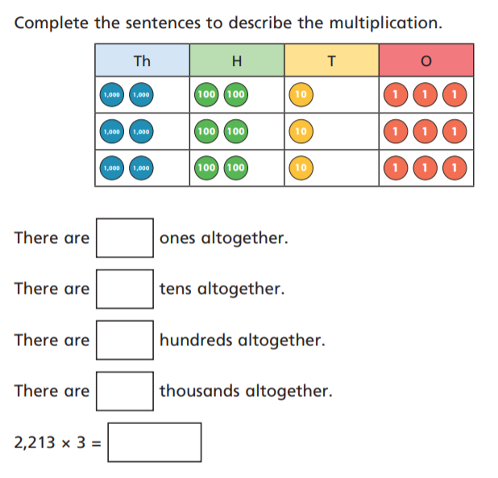
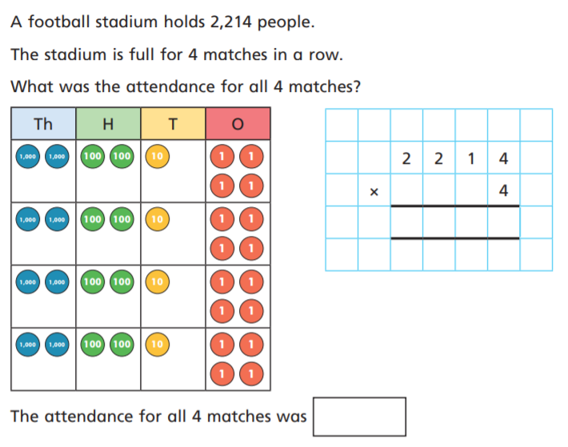
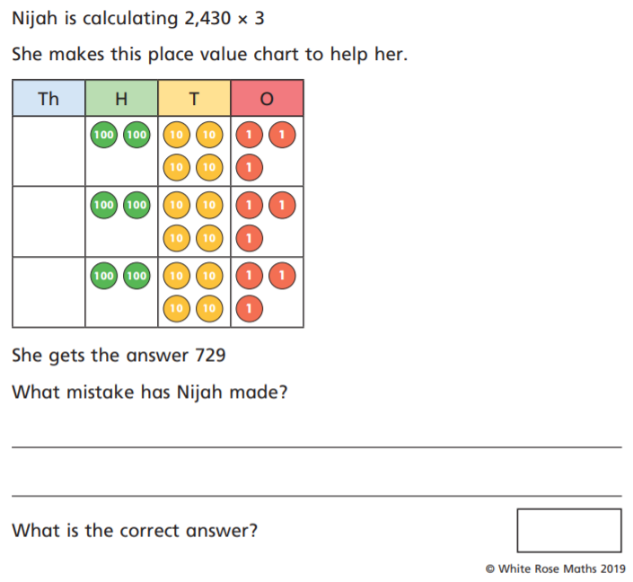
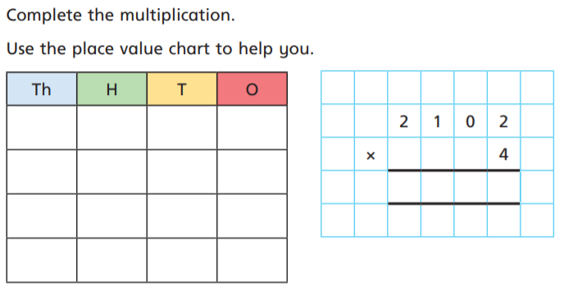
2
4
1
3
6
5

Slide 2
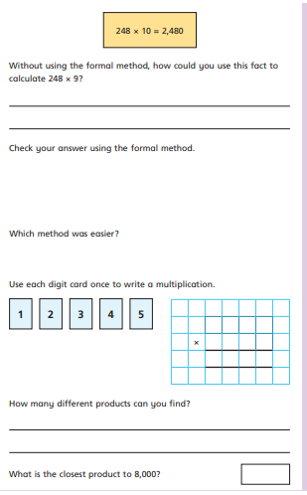
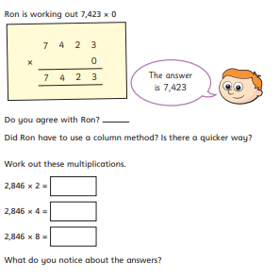
Some extra questions if you finish

Slide 3
2
4
1
7209
9
8 8 5 6
3
6
She placed the tens in the 1s ones
6
6639
8 8 5 6
5
3
6
9378
9624
3 x 50 -6 = 144
8 4 0 8
24 792
2 X 24 = 48
7510
48 + 144 =192

